Slide 1
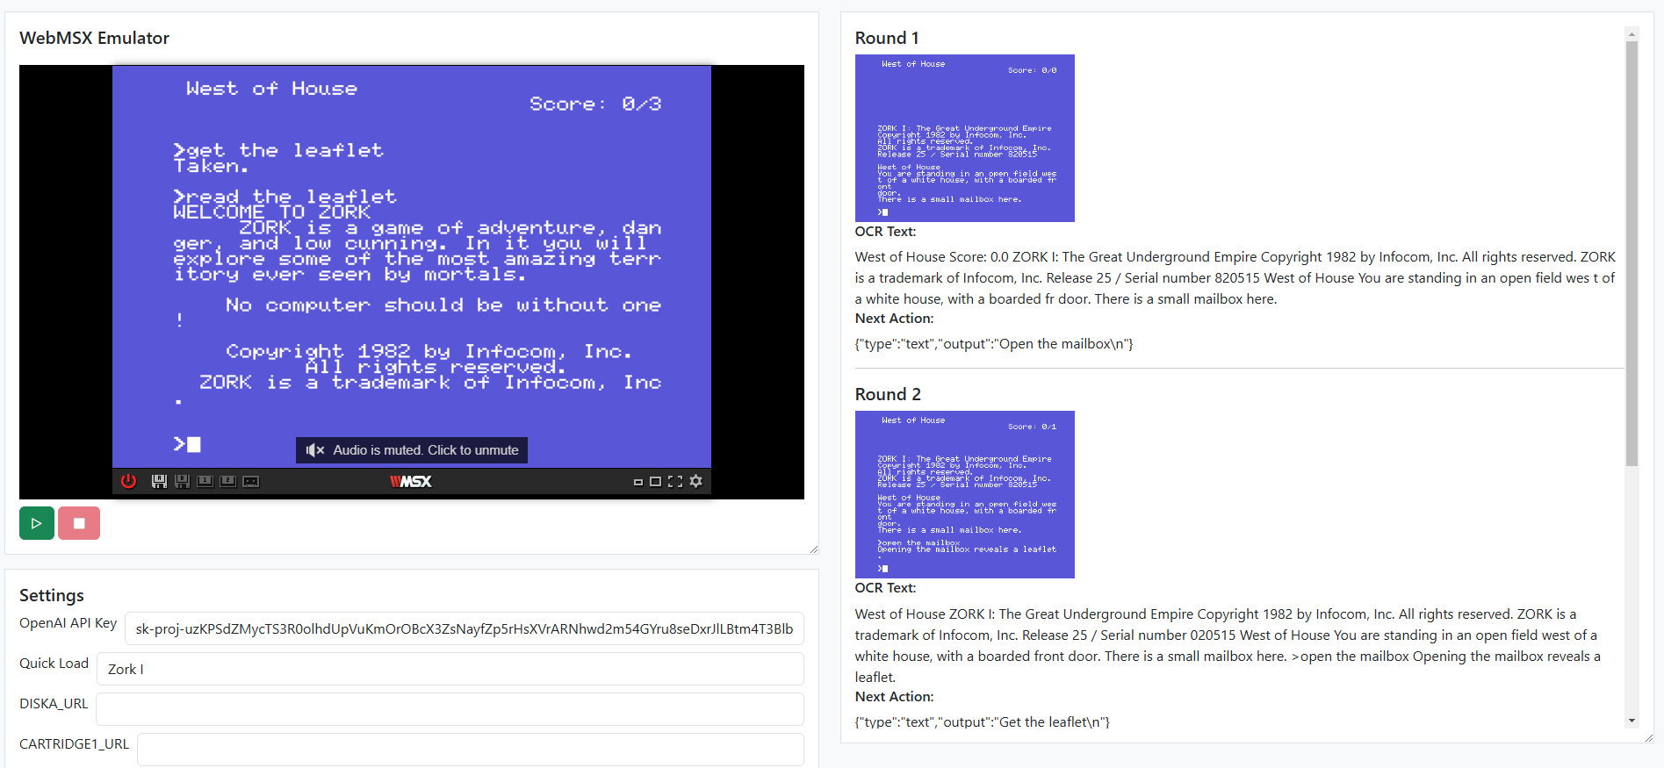
1
2
3
4

Slide 2
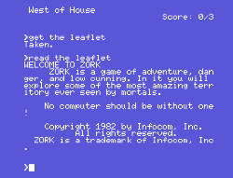

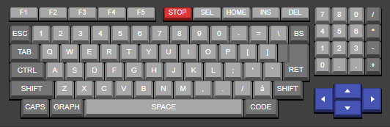

Emulator running game
Take screenshot
1
2
OCR (Image to Text)
Next action is taken
Command is typed
3
4
5
“West of House Score: 0/3 >get the leaflet Taken. >read the leaflet WELCOME TO ZORK ZORK is a game of adventure, danger and low cunning. In it you will explore some of the most amazing territory ever seen by mortals. No computer should be without one! Copyright 1982 by Infocom, Inc. All rights reserved. ZORK is a trademark of Infocom, Inc.”
Next Action: “GO NORTH”
Next round

